Slide 1
Capstone Project - 1 Global Terrorism Analysis TEAM MEMBERS
Yeshamina. Kamal
Vaddempudi. Tejaswini

Slide 2


Slide 3

Global terrorism Analysis
1.) Defining Problem Statement
2.) Importing libraries
3.) Descriptive Statistics
4.) Missing value imputation
5.) Graphical representation

Slide 4
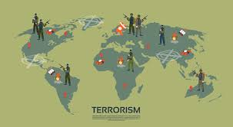

Global Terrorism
Terrorism poses a direct threat to the security of the citizens of NATO countries, and to international stability and prosperity. It is a persistent global threat that knows no border, nationality or religion. The idea of this project is to create a Exploratory Data Analysis report through which we can identify the most affected region, pattern of attack and weapons used in Terrorist activities. We divided whole analysis in four parts as mentioned

Slide 5
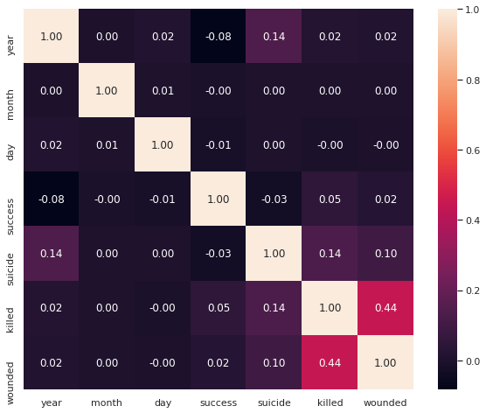
Heat Map
Heatmap conclude that correlation between any two columns
some data part of Heatmap is having
positive correlation
some data part of Heatmap is having
zero correlation
And very few data is showing Negative correlation

Slide 6
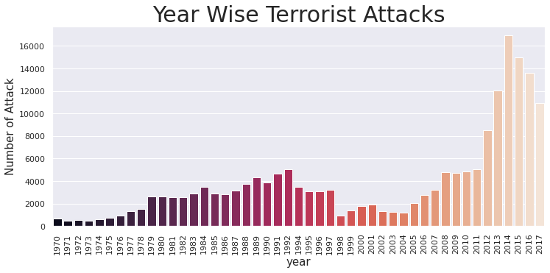
Year wise terrorist attacks
Bar diagram indicates the year wise Terrorist attacks ,
from this we can conclude that-
Most frequently Terrorist
attacks happen in 2014

Slide 7
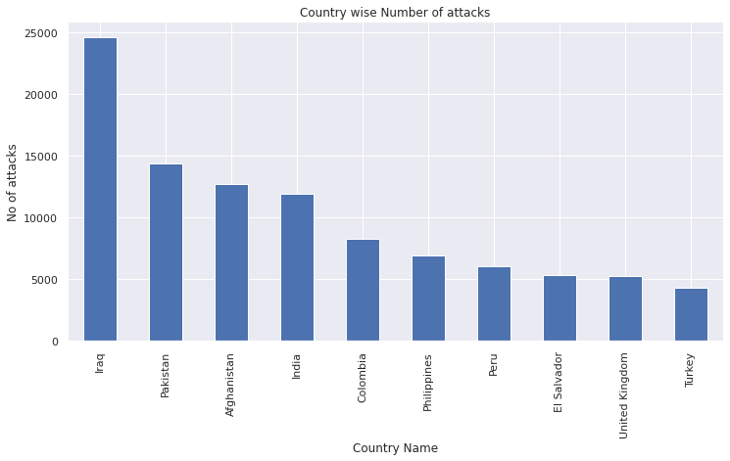
Country wise Terrorist attacks
From this Bar diagram, we concluded that
"IRAQ" is first place in top
10 most terrorist attacked country
followed by pakistan,Afghanistan,
India..etc

Slide 8
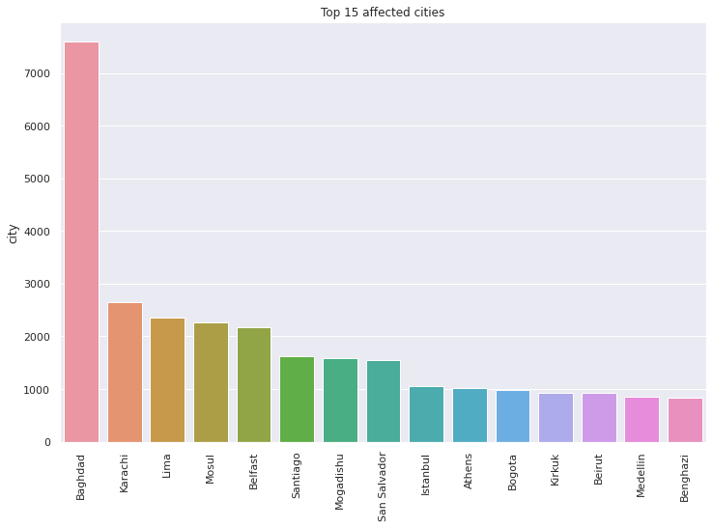
City wise terrorist attacks
Barplot tells that
“Baghdad” is the most affected
city in the world,by terrorist
attacks with 7985 times .

Slide 9
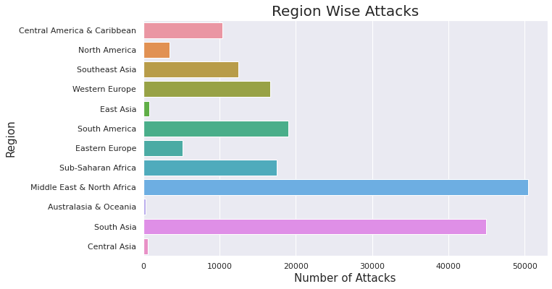
Region Wise Attacks
It's clearly showing that Middle
East & North Africa,South Asia
Regions are most affected regions
by terrorist attacks with nearly
50474 attacks.

Slide 10
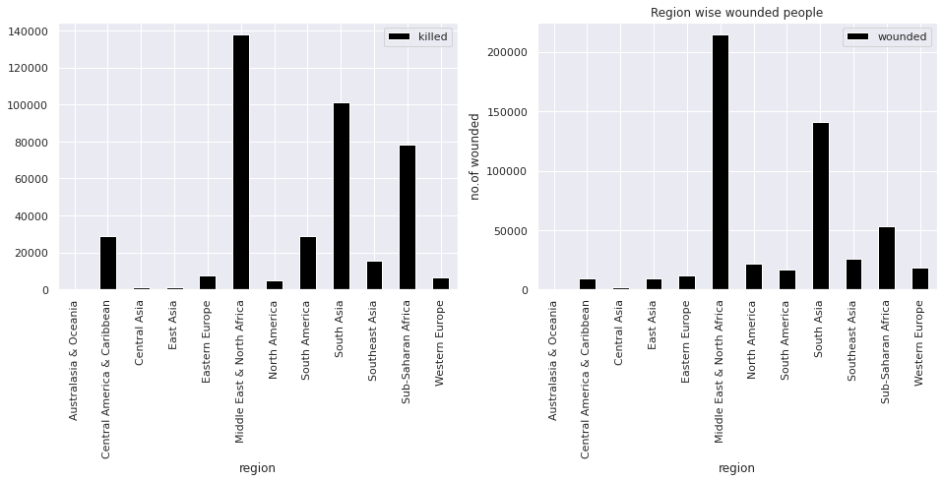
Region wise kills and wounds
1.) We can conclude that most people killed in Middle East & North Africa .
2.) Most people got wounded in Middle East & North Africa

Slide 11
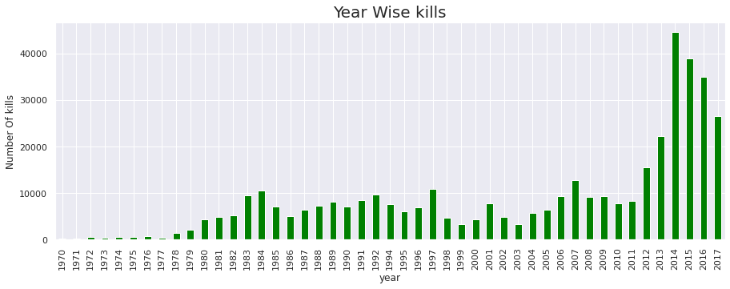
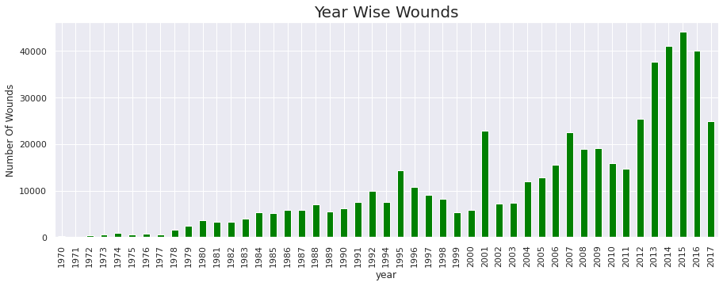
Year wise kills and wounds
Maximum number of people were killed 2014.
Maximum number of people got wounded in 2015.
In 1970’s the rate of kills and wounds is very low

Slide 12
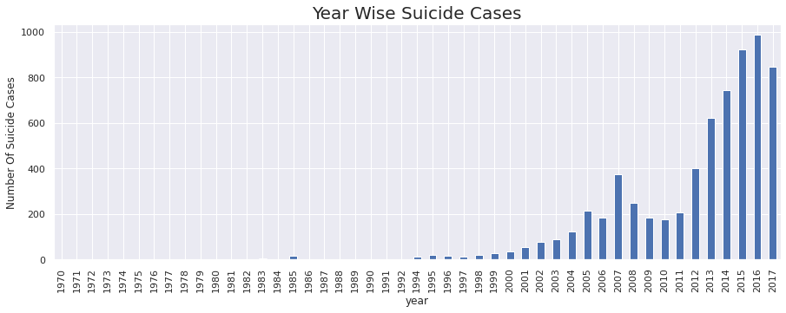
Suside analysis
It's clearly showing that the highest
number of suicide cases are in the
year 2016 followed by 2015,2017,
and so on.

Slide 13
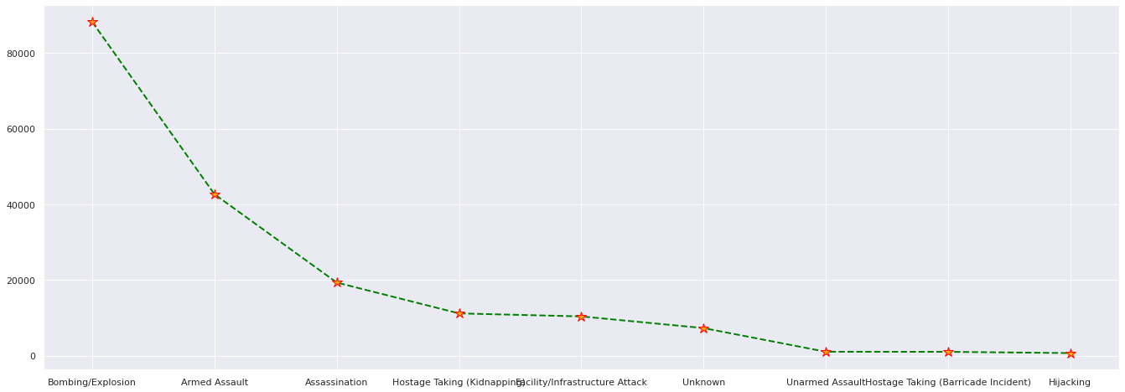
Type of terrorist attacks
from the graph we can conclude that most number of attacks were done by using "Bombing/Explosion" , this type of attack was used 88255 times.
Least type of attack used was "Hijacking" ,it was used only 659 times

Slide 14
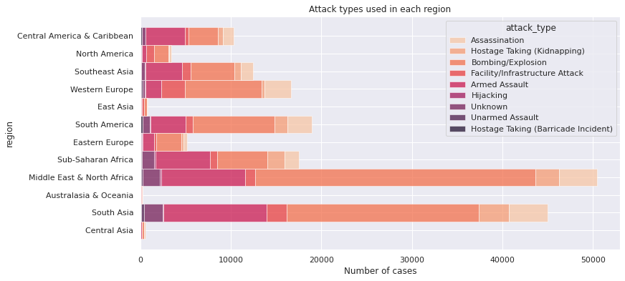
Attack type used in each region
By observing the plot, we
conclude that most attacks were
done in middle east & north africa
and type of attack used most is
Bombing/Explosion

Slide 15
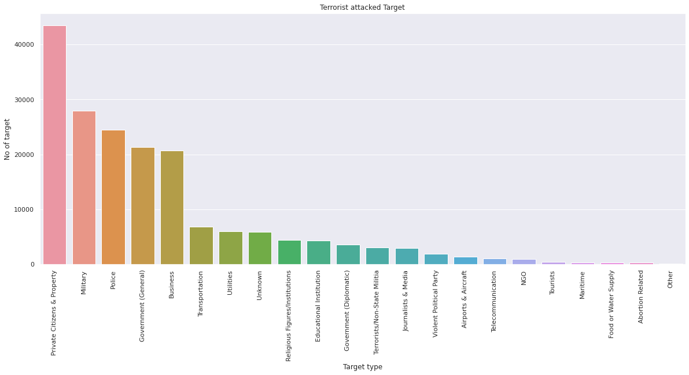
Attack Based on Target type
By the graph, we can
conclude that
the terrorist mainly target on
"Private Citizens & Property"
for attacks in which they attacked
43511 times

Slide 16
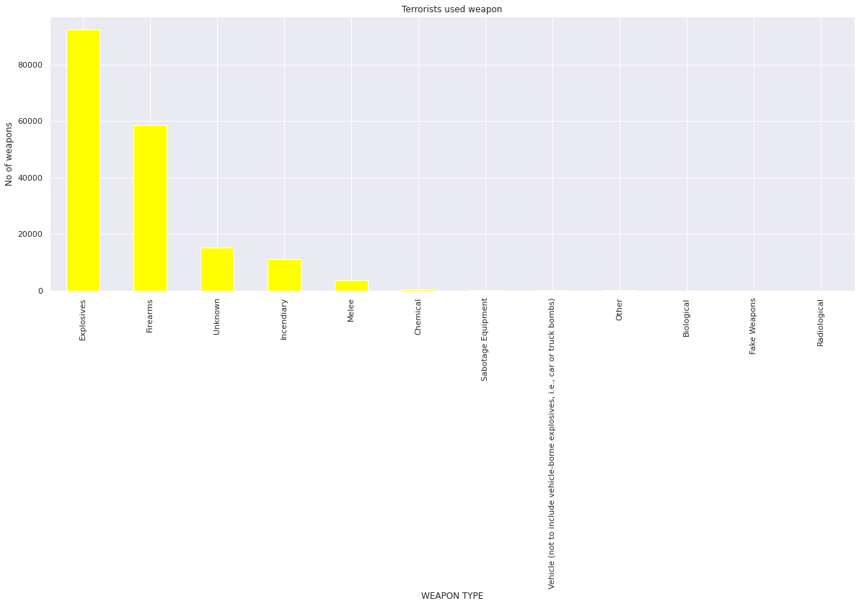
Attacks based on weapons
The terrorists mostly use "Explosive"
type weapons,used 92426 times and
rarely used weapon was "Radiological",
it was used only 14 times

Slide 17
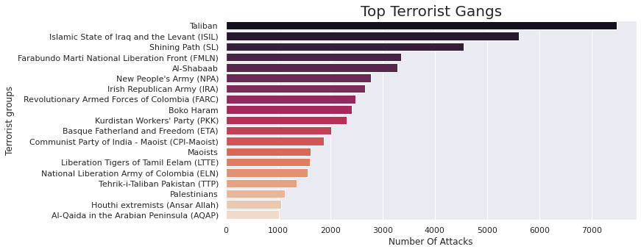
Top Terrorist Gangs
Taliban is the most dangerous gang which is in top with 7478 attacks followed by ISIL with 5163 attacks

Slide 18
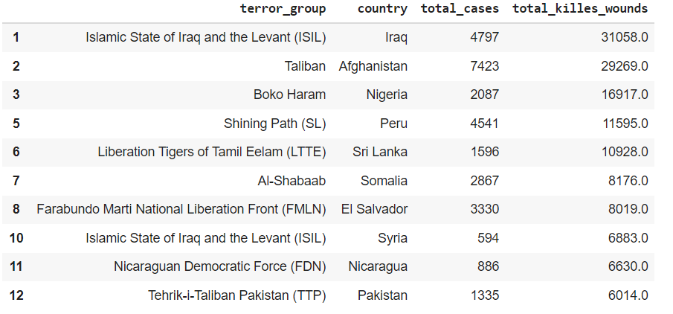
Terrorist group Active region
Taliban is active in
Afganistan of South Asia region
ISIL is active in Iraq of Middle
East & North Africa Region

Slide 19
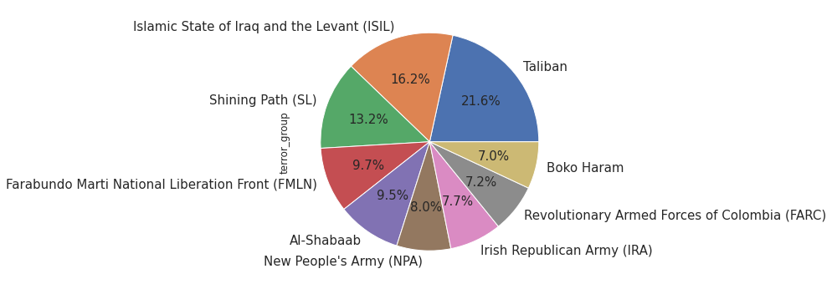
Most active terrorist group
Taliban is the most active terrorist group then followed by ISIL.

Slide 20
CONCLUSION
From our study,we conclude that
Middle East & North Africa,South Asia,South America Regions are 3 most affected regions by terrorist attacks.
Iraq is the most affected country following by Pakistan,Afghanistan,India,Colombia,etc.
where as moving to cities, the baghdad was most affected city with 7589 attacks.
Taliban is the Most dangerous Terrorist Group.
The year 2014 witnessed the highest number of terrorist attack and after 2004 the number of terrorist attacks started increasing.and in 1970's no.of attacks were very low.
Mostly Bombing Explosion attack type is used by the terrorists.
Terrorists are mostly Targeting on private citizen & property,Military,police,Government,business persons,etc.
terrorist groups mostly use explosives,firearms,incendiary,melee for attacks
The highest number of suicide cases are in the year 2016 followed by 2015,2017,2014,2013 and so on.
The highest number of kills are done by Bombing/Explosion method in each year.

Slide 21


Slide 22


Slide 23


